Slide 1

ABC to Machine Learning
-Xinyu Zhong
Notes:
I wou

Slide 2
Supervised Learning | Model
Regression& Classification | Decision Tress
 | Regression Analysis
 | Neural Network
Classification | Deep Neural Network
 | Gaussian Process, etc.
Application of ML in Physics Research (Astrophyisc, particle phyiscs, material science)

Slide 3
Classification and Regression
 | Classification | Regression
Predicted Variable, f(x) | A discrete quantity | A continuous quantity
Commonly seen methods | Decision Trees | Linear Regression, Polynomial Regression, Neural Network, Gaussian Regression
Example of application in physics research | Categorization of stars, galaxy, clusters Measuring photometric redshifts using galaxy image. | Predicting material property Jet mass calibration
Evaluation of performance of Model | Accuracy, F1-Metric, Confusion Matrix | Mean square error
Notes:
Measuring photometric redshifts using galaxy images and Deep Neural Networks
https://www.sciencedirect.com/science/article/pii/S221313371630021X

Slide 4
Machine Learning Methods
ML Method | Requirement for data | Computational resource | Interpretibility | Other advangtage/limitation
Decision Tree | Little requirement | Relatively few | Good with a nice visualisation (tree diagram) | Limited capability for regression,
Linear Regression | Average | Relatively few | Good | Could not handle non-linear cases. Less prone to overfitting
Neural Network | Perform well with Large amount of data points | Computationally Expensive | Black-box, hard to interpret result | Prone to over-fitting
Deep Neural Network | Perform well with Large amount of data points | Even more Computationally Expensive | Black-box, hard to interpret result | Prone to over-fitting
Gaussian Process | Perform well with limited amount of data points | Computationally expensive | Black-box, hard to interpret result | Gives uncertainty estimate

Slide 5
Use of ML technique in physics research

Slide 6
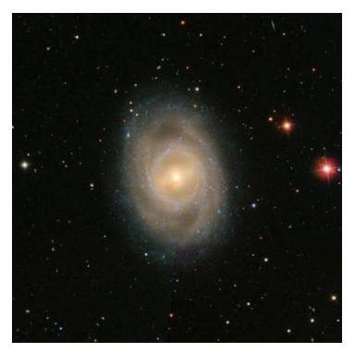
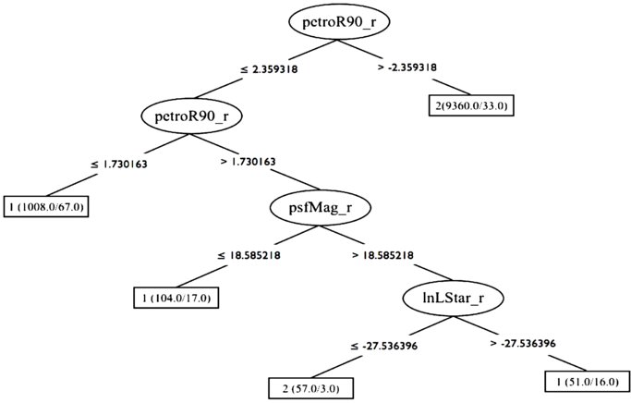
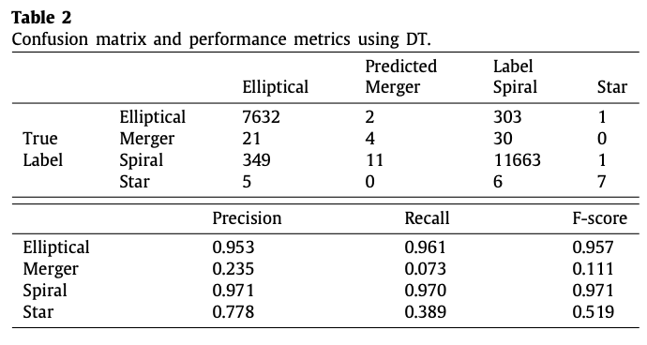
DT example: Galaxy morphological classification
a system used by astronomers to divide galaxies into groups based on their visual appearance.
E.g. Elliptical galaxies, Spiral galaxies, Star, Mergers
Reza, M. (2021). Galaxy morphology classification using automated machine learning. Astronomy and Computing, 37, 100492. https://doi.org/10.1016/j.ascom.2021.100492
‌
Notes:
https://www.sciencedirect.com/science/article/pii/S2213133721000469?pes=vor

Slide 7

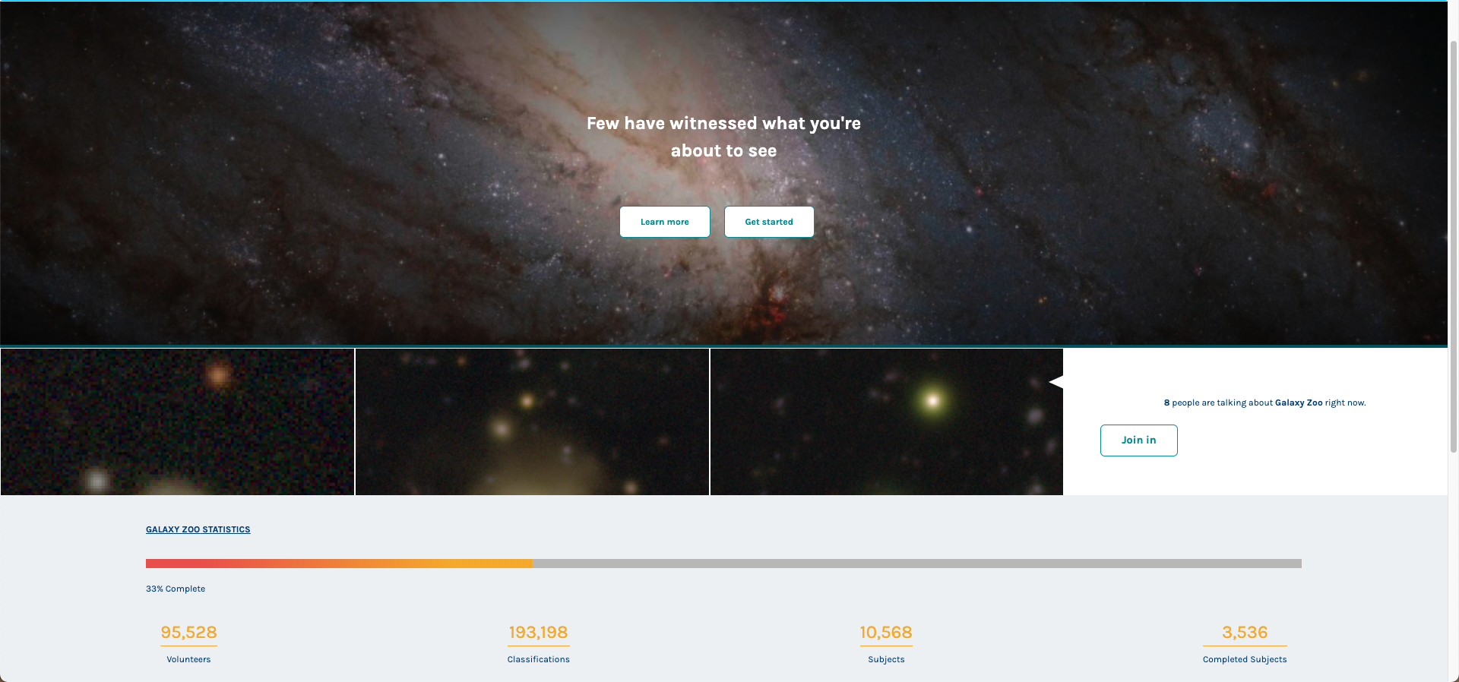

Slide 8
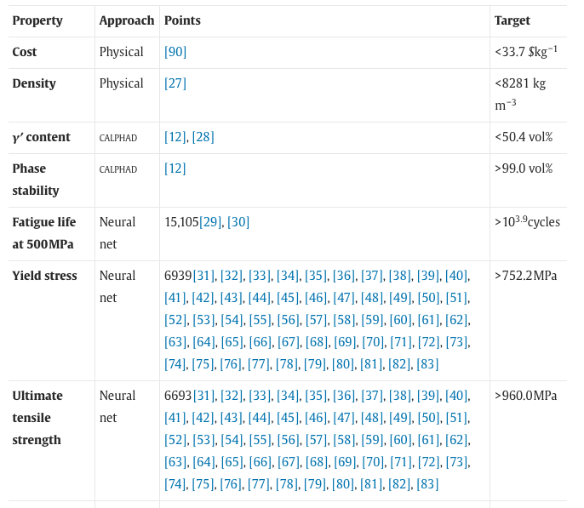
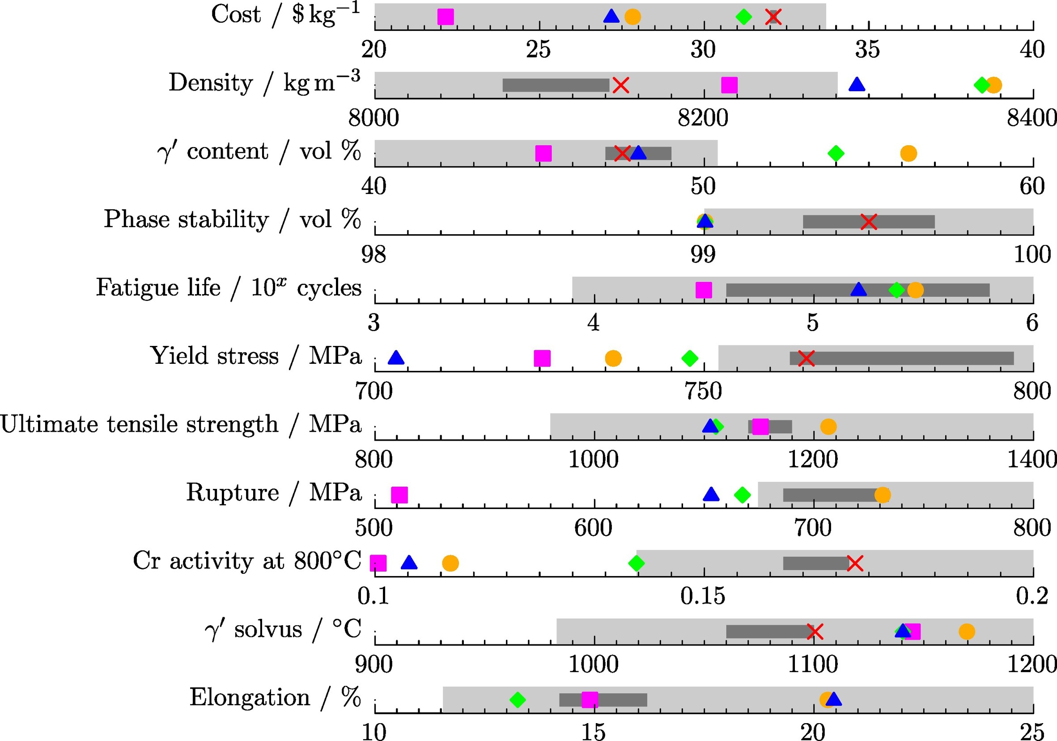
NN example: prediction of material property
Predict the expected value and the associated uncertainty in a material‘s physical property
Conduit, B.D., Jones, N.G., Stone, H.J. and Conduit, G.J. (2017). Design of a nickel-base superalloy using a neural network. Materials & Design, 131, pp.358–365.
Notes:
https://www.scopus.com/record/display.uri?eid=2-s2.0-85021133654&origin=resultslist&sort=cp-f

